Slide 1


THE BETTER POLICY PROJECT
AI-POWERED LEARNING
Next Generation of Policy
Frameworks and Modeling
WEEK 2 · JUNE 15-19, 2026
Risk-Adjusted UIP
Chulalongkorn University · Bangkok, Thailand

Slide 2

Risk-Adjusted UIP
Compensation for Expected Depreciation (in log terms)
$i_{t}=\left[s_{t+1}−s_{t}\right]$+[$i_{t}^{f}+u_{t}$]
Domestic Interest Rate
Foreign Interest Rate
Country Risk Premium

Slide 3

Derive Multi-Period Risk Adjusted UIP
$i_{t} = \left[s_{t+1}−{ s}_{t}\right]$ + [$i_{t}^{f}+u_{t}$]

Slide 4

Derive Multi-Period Risk Adjusted UIP
$i_{t} = \left[s_{t+1}−{ s}_{t}\right]$ + [$i_{t}^{f}+u_{t}$]
$i_{t+1} = \left[s_{t+2}−{ s}_{t+1}\right]$ + [$i_{t+1}^{f}+u_{t+1}$]

Slide 5
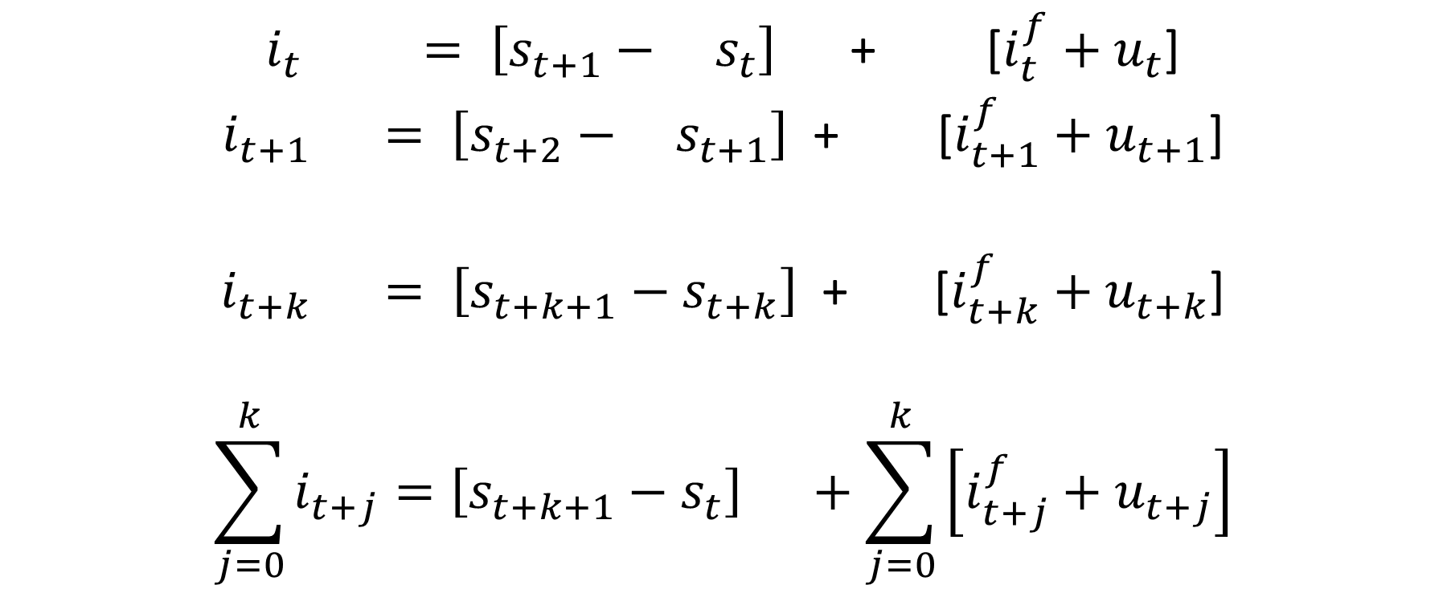
Derive Multi-Period Risk Adjusted UIP
$i_{t} = \left[s_{t+1}−{ s}_{t}\right]$ + [$i_{t}^{f}+u_{t}$]
$i_{t+1} = \left[s_{t+2}−{ s}_{t+1}\right]$ + [$i_{t+1}^{f}+u_{t+1}$]
$i_{t+k} = \left[s_{t+k+1}−s_{t+k}\right]$ + [$i_{t+k}^{f}+u_{t+k}$]
$$\sum_{j=0}^{k}{i_{t+j}=\left[s_{t+k+1}−s_{t}\right] +\sum_{j=0}^{k}{\left[i_{t+j}^{f}+u_{t+j}\right]}}$$

Slide 6
Derive Multi-Period Risk Adjusted UIP
$i_{t} = \left[s_{t+1}−{ s}_{t}\right]$ + [$i_{t}^{f}+u_{t}$]
$i_{t+1} = \left[s_{t+2}−{ s}_{t+1}\right]$ + [$i_{t+1}^{f}+u_{t+1}$]
$i_{t+k} = \left[s_{t+k+1}−s_{t+k}\right]$ + [$i_{t+k}^{f}+u_{t+k}$]
$$\sum_{j=0}^{k}{i_{t+j}=\left[s_{t+k+1}−s_{t}\right] +\sum_{j=0}^{k}{\left[i_{t+j}^{f}+u_{t+j}\right]}}$$

Slide 7
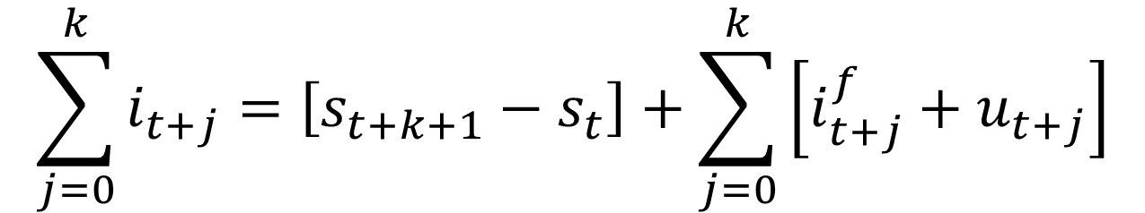
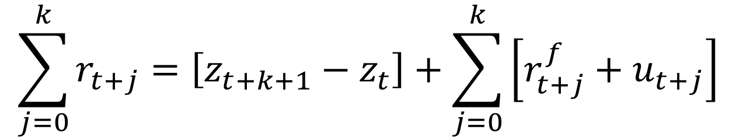
Important Insights from Risk-Adjusted UIP
Expected policy rate path
Expected depreciation
Expected foreign policy rate path adjusted for country risk premium
$$\sum_{j=0}^{k}{i_{t+j}=\left[s_{t+k+1}−s_{t}\right]+\sum_{j=0}^{k}{\left[i_{t+j}^{f}+u_{t+j}\right]}}$$
Expected real policy rate path
Expected real depreciation
Expected real foreign policy rate path adjusted for country risk premium
$$\sum_{j=0}^{k}{r_{t+j}=\left[z_{t+k+1}−z_{t}\right]+\sum_{j=0}^{k}{\left[r_{t+j}^{f}+u_{t+j}\right]}}$$

Slide 8
Important Insights from Risk-Adjusted UIP
Expected policy rate path
Expected depreciation
Expected foreign policy rate path adjusted for country risk premium
$$\sum_{j=0}^{k}{i_{t+j}=\left[s_{t+k+1}−s_{t}\right]+\sum_{j=0}^{k}{\left[i_{t+j}^{f}+u_{t+j}\right]}}$$
Expected real policy rate path
Expected real depreciation
Expected real foreign policy rate path adjusted for country risk premium
$$\sum_{j=0}^{k}{r_{t+j}=\left[z_{t+k+1}−z_{t}\right]+\sum_{j=0}^{k}{\left[r_{t+j}^{f}+u_{t+j}\right]}}$$

Slide 9
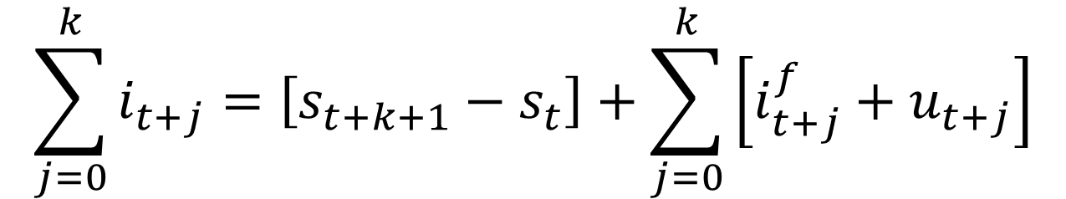
Market Interest Rates and Exchange Rates As Shock Absorbers
Negative demand shock reduces inflation in the short run. IFT CB expected to reduce the policy rate sufficiently to steer inflation back to target.
$$\sum_{j=0}^{k}{i_{t+j}=\left[s_{t+k+1}−s_{t}\right]+\sum_{j=0}^{k}{\left[i_{t+j}^{f}+u_{t+j}\right]}}$$
Nominal exchange rate also depreciates today. Easier monetary conditions coming from both interest rates and exchange rates.
An important assumption: nominal exchange rate in the long-run does not change. Under what conditions will it happen?

Slide 10
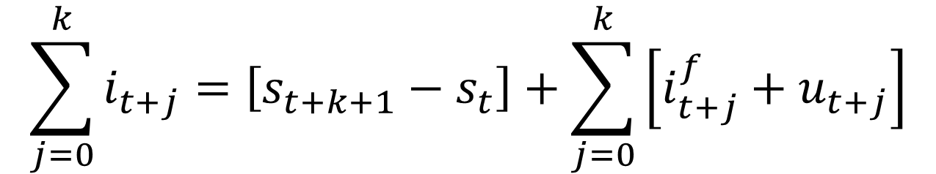
[Expected Domestic Interest Rates = Expected Nominal Depreciation + Expected Foreign Interest Rates Plus Risk Premium]
$$\sum_{j=0}^{k}{i_{t+j}=\left[s_{t+k+1}−s_{t}\right]+\sum_{j=0}^{k}{\left[i_{t+j}^{f}+u_{t+j}\right]}}$$
a) -200 bps
=
0 %
-
(2 %) (significant depreciation today)
Notice the sign flips!
b) -100 bps
=
-0.8 %
-
(0.2 %) (less depreciation today)
c) 0 bps
=
-2 %
-
(-2 %) (significant appreciation today)
≈2%
lower

Slide 11
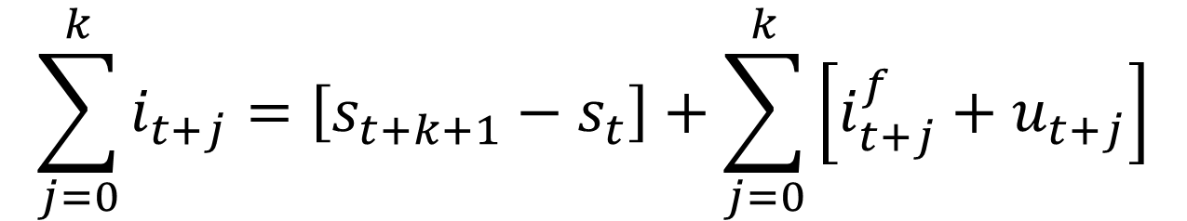
Market Interest Rates and Exchange Rates As Shock Amplifiers
Negative demand shock reduces inflation in the short run. When the nominal interest rate is constrained by the ZLB, inflation can ratchet downwards, causing nominal exchange rate to appreciate.
$$\sum_{j=0}^{k}{i_{t+j}=\left[s_{t+k+1}−s_{t}\right]+\sum_{j=0}^{k}{\left[i_{t+j}^{f}+u_{t+j}\right]}}$$
Real interest rate also rises which contracts the economy even further.
$$r_{t}=i_{t}+E_{t}π_{t+1}$$

Slide 12
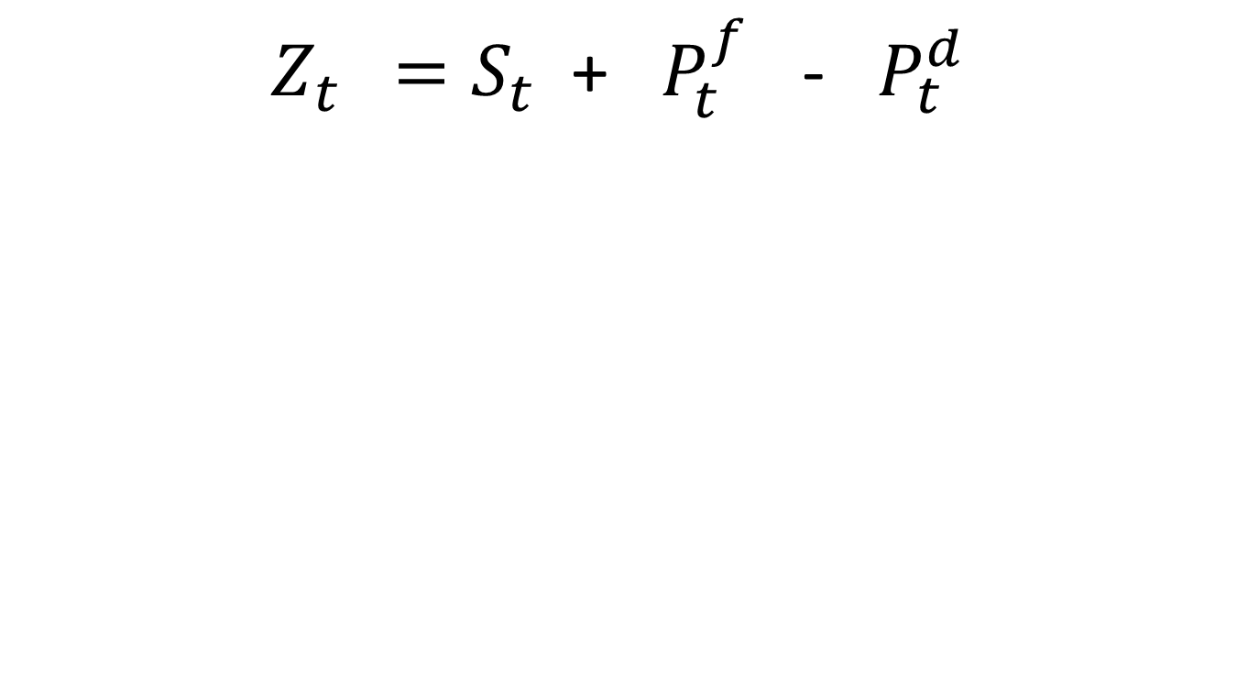
Real Exchange Rate
$Z_{t } =S_{t}$ + $P_{t}^{f}$ - $P_{t}^{d}$

Slide 13
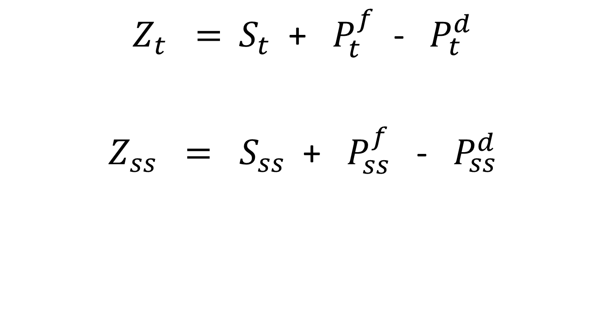
Real Exchange Rate
$Z_{t} ={ S}_{t}$ + $P_{t}^{f}$ - ${ P}_{t}^{d}$
$Z_{ss} = S_{ss}$ + $P_{ss}^{f}$ - $P_{ss}^{d}$

Slide 14
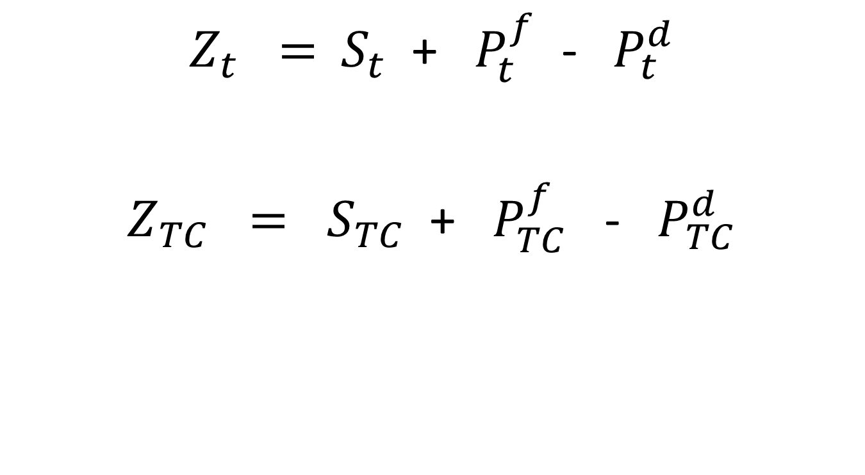
Real Exchange Rate
$Z_{t} ={ S}_{t}$ + $P_{t}^{f}$ - ${ P}_{t}^{d}$
$Z_{TC} = S_{TC}$ + $P_{TC}^{f}$ - $P_{TC}^{d}$

Slide 15
Real Exchange Rate
$Z_{t} ={ S}_{t}$ + $P_{t}^{f}$ - ${ P}_{t}^{d}$
$Z_{TC} = S_{TC}$ + $P_{TC}^{f}$ - $P_{TC}^{d}$

Slide 16
Market Interest Rates and Exchange Rates As Shock Amplifiers
Negative demand shock reduces inflation in the short run. When the nominal interest rate is constrained by the ZLB, inflation can ratchet downwards, causing nominal exchange rate to appreciate.
$$\sum_{j=0}^{k}{i_{t+j}=\left[s_{t+k+1}−s_{t}\right]+\sum_{j=0}^{k}{\left[i_{t+j}^{f}+u_{t+j}\right]}}$$
Real interest rate also rises which contracts the economy even further.
$$r_{t}=i_{t}+E_{t}π_{t+1}$$

Slide 17
Example of Shock Amplifier Canada versus Japan after the Global Financial Crisis
 | Real GDP Growth | Real Export Growth | Output Gap | CPI Inflation | 3-yr Ahead Inflation Expectation | Long-term Interest Rate | Short-term Interest Rate | Bilateral USD Exchange Rate
 | Canada
2007 | 2.0 | 1.1 | 1.9 | 2.1 | 2.1 | 4.3 | 4.2 | 100.0
2008 | 1.2 | -4.5 | 0.9 | 2.4 | 2.1 | 3.6 | 2.4 | 99.3
2009 | -2.7 | -13.1 | -3.5 | 0.3 | 2.1 | 3.2 | 0.4 | 106.4
 | Japan
2007 | 2.2 | 8.7 | 0.4 | 0.1 | 0.9 | 1.7 | 0.6 | 100.0
2008 | -1.0 | 1.4 | -1.4 | 1.4 | 0.9 | 1.5 | 0.4 | 87.8
2009 | -5.5 | -24.2 | -7.1 | -1.3 | 0.3 | 1.4 | 0.1 | 79.5
Note: Numbers in the table are in percent. Bilateral USD exchange rate is normalized to 100 in 2007.
Source: IMF World Economic Outlook October 2014.

Slide 18
Example of Shock Amplifier Japanese Yen Appreciates on Bad News
Source: Haver Analytics.

Slide 19




THE BETTER POLICY PROJECT
AI-POWERED LEARNING
Great Things are Coming.
Website
www.thebetterpolicyproject.org
E-mail
douglaslaxton@thebetterpolicyproject.org
AI-Powered Learning
www.ai-powered-learning.org
Venue
Chulalongkorn University · Bangkok, Thailand
THE BETTER POLICY PROJECT

